Slide 1
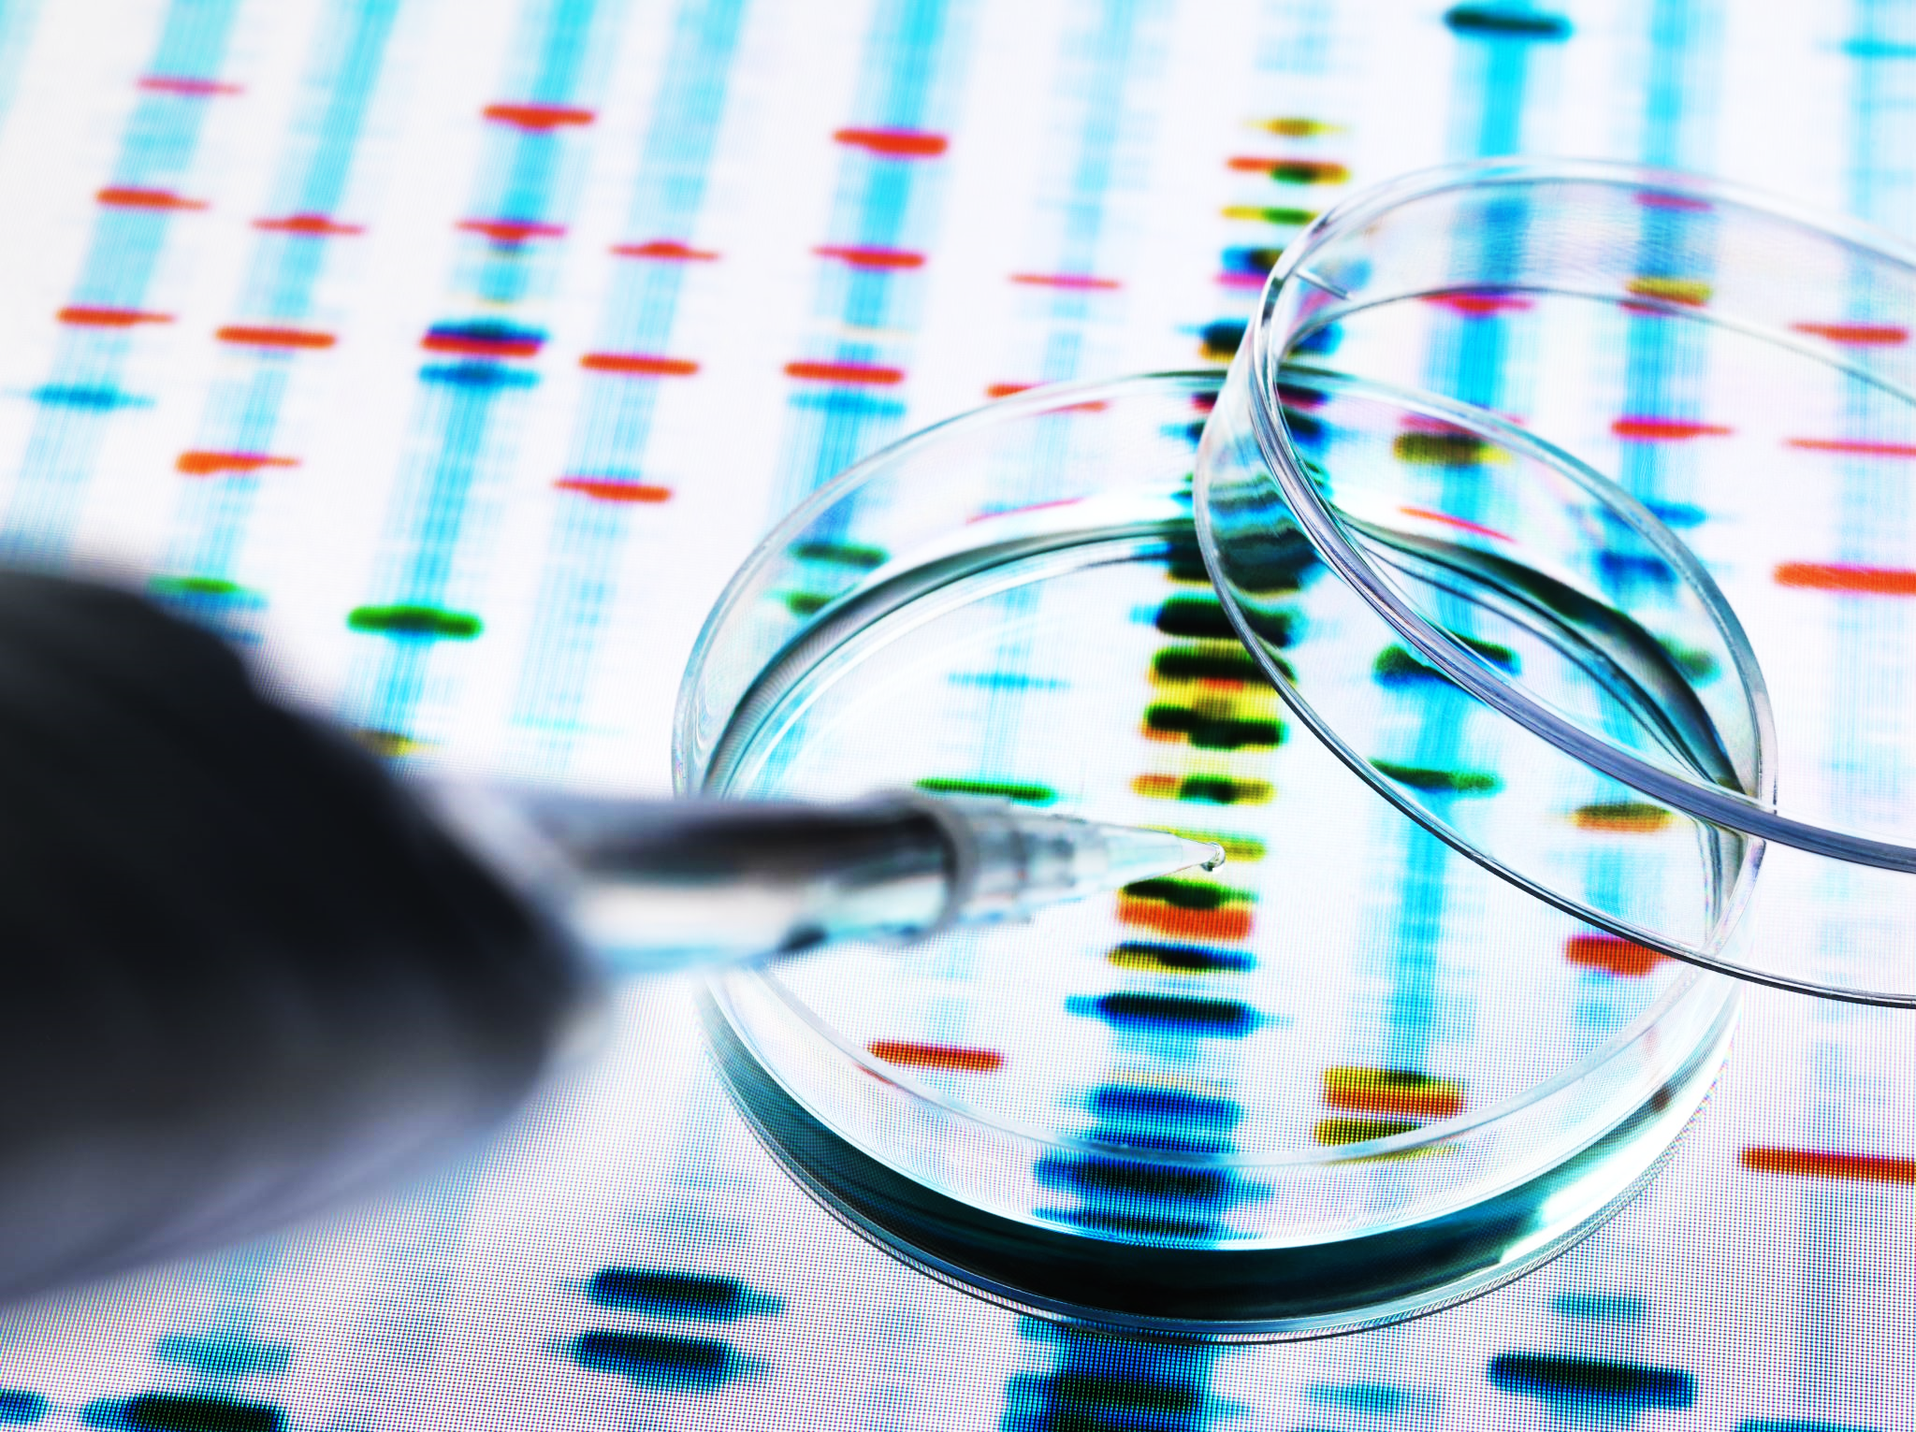
MALARIA DETECTION
Deep Learning Image Classification with TensorFlow

Slide 2
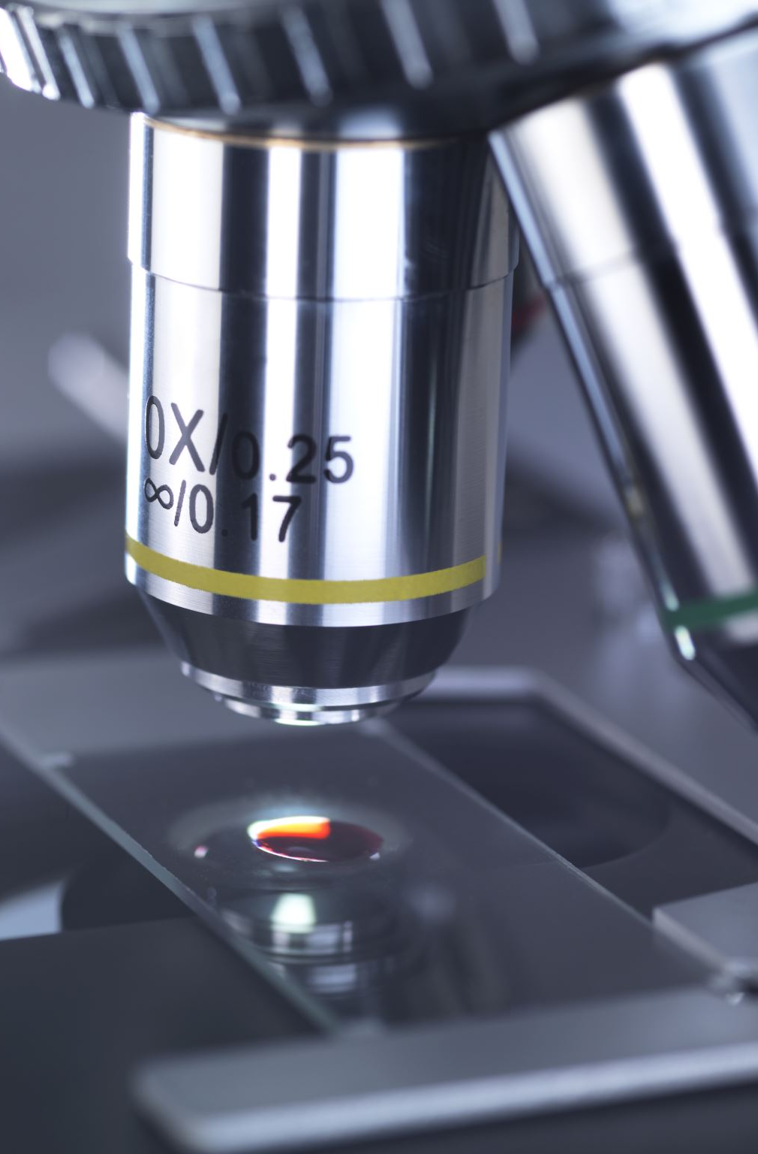
Introduction
A life-threatening disease caused by Plasmodium parasites transmitted through mosquito bites, remains a global health challenge.
2023: WHO reported 247M malaria cases, and 619K deaths.
2019-2021: Malaria cases surged by 13M globally.
Labor-intensive methods cause treatment delays.
Automation revolutionizes malaria detection, aiding resource-constrained regions.
Developed a binary classification deep learning model utilizing the LeNet architecture in Keras with TensorFlow for analyzing blood cell thin smear images.

Slide 3

Dataset
Source: TensorFlow Datasets
Size: 337 MB
Labels: Parasitized (0) and Uninfected (1)
Total Images: 27,558
Parasitized Samples: 13,779
Uninfected Samples: 13,779
Image Dimensions: Varying
Image Format: JPEG

Slide 4
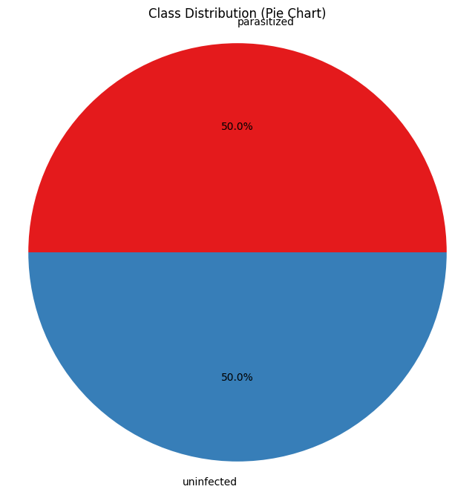
Data Distribution
The Malaria dataset contains a total of 27,558 cell images with equal instances of parasitized and uninfected cells from the thin blood smear slide images of segmented cells.

Slide 5
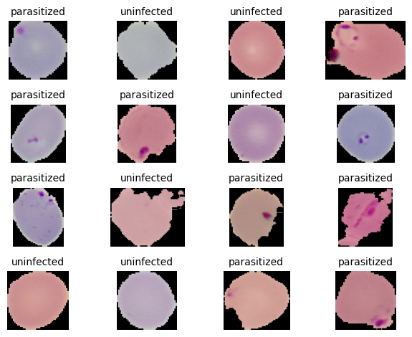
Dataset Samples
Label 0: parasitized (13,779 images)
Label 1: uninfected (13,779 images)

Slide 6

Data Preparation
Data Splitting:
Training Data: 80%
Validation Data: 10%
Testing Data: 10%
Data Preprocess:
Image Resizing (224*224*3)
Image Rescaling (resized_image/255)
Image Augmentation (rot90, adjust_saturation, flip_left_right)

Slide 7
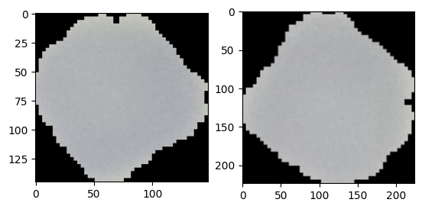
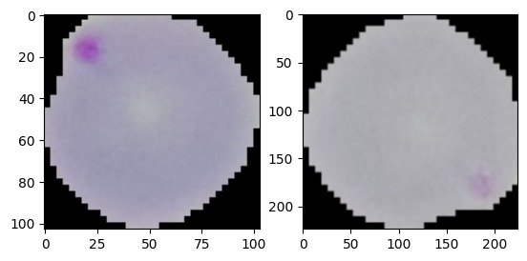
Data Preprocessing
Uninfected Sample
Infected Sample

Slide 8

LeNet Model
Binary Classification: The model distinguishes between malaria-infected and uninfected blood smear images.
Sequential API: Utilized for building the neural network architecture in a linear stack of layers.
LeNet Model: Employed as the backbone architecture for feature extraction and classification.
TensorFlow: Framework used for implementing and training the deep learning model.
Key Components: Input layer, convolutional layers, max-pooling layers, fully connected layers, and output layer for prediction.

Slide 9
Model Configuration
Learning Rate: 0.001
Number of Epochs: 10
Batch Size: 128
Image Size: 224
Number of Filters: 6
Kernel Size: 3
Number of Strides: 1
Pooling Size: 2
Number of Neurons in the First Dense Layer: 100
Number of Neurons in the Second Dense Layer: 10

Slide 10
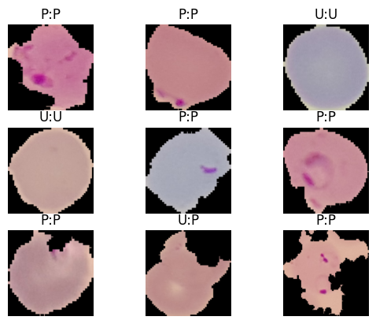
Model evaluation
Achieved accuracy of 97% on test data.
The threshold considered is 0.5.
Saved model and weights as .h5 and .hdf5 files.

Slide 11
Model Deployment
The complete model is developed as a user-friendly application using Streamlit.
Malaria Detection – Streamlit Application

Slide 12

Conclusion
Achieved 97% accuracy on test data, demonstrating robust model performance.
Leveraged optimized hyperparameters for efficient training and accurate predictions.
Future Scope:
Boost efficiency by integrating advanced architectures like ResNet, DenseNet, or EfficientNet.
Enhance the user experience by filtering out irrelevant images interactively.
Developing a batch prediction model capable of processing entire datasets efficiently.

Slide 13

References
Neuralearn
WHO
Ye, J., Si, R., & Wei, T. (2021). Classification of images by using TensorFlow. In 2021 6th International Conference on Intelligent Computing and Signal Processing (ICSP) (pp. 1-5). IEEE. DOI: 10.1109/ICSP51882.2021.9408796
Fuhad, K. M. Faizullah, Tuba, Jannat Ferdousey, Sarker, Md. Rabiul Ali, Momen, Sifat, Mohammed, Nabeel, & Rahman, Tanzilur. (2020). Deep Learning Based Automatic Malaria Parasite Detection from Blood Smear and Its Smartphone Based Application. Diagnostics (Basel), 10(5), 329. doi: 10.3390/diagnostics10050329
Zhou, L., & Yu, W. (2022). Improved Convolutional Neural Image Recognition Algorithm based on LeNet-5. Journal of Computer Networks and Communications, 2022(2), 1-5. DOI: 10.1155/2022/1636203. Published by Hindawi under the CC BY 4.0 license.

Slide 14
THANK YOU
Guided by:
Dr. Chaojie (Jay) Wang
Presented by:
Srinivas Naidu Pasyavula
University of Maryland Baltimore County
QC61851

